Slide 1
Fundamentals of Networks and Security
Vassilis Markos
Mediterranean College
Week 07

Slide 2
A Quick Revision

Slide 3
What we saw last time… 1 / n
Name some things to consider when buying network equipment.
A few things to take into account are:
Cost
Connectivity (e.g., ports on switches / routers)
Availability
Usability
The future.

Slide 4
What we saw last time… 2 / n
Why install a firewall between two departments of the same business?
Some reasons include:
To avoid potential damage at one place spreading to others.
To avoid internal breaches.
To ensure people at your business do (only) what they are supposed to.
How to protect network devices against physical damage?
Some ways are:
Physical containers (put your precious machines in protective boxes)
Choose places with limited access (e.g., areas where you can observe, or where there is no free access or where access is noticeable).

Slide 5
What we saw last time… 3 / n
Which things you should consider when placing equipment?
Some important things include:
Heat and voltage.
Physical distance.
Cost and complexity.
RFI / EMI.
Reliability.

Slide 6
What we saw last time… 4 / n
Best and worst practices about trunking include…
Passing a trunk through a wall to connect adjacent rooms.
You can do so through a ceiling to connect adjacent floors.
You cannot do so through doors (guess why).
Take advantage of ceiling voids! (the gap between the actual and false ceilings).

Slide 7
Ethernet Protocol

Slide 8
Ethernet Protocol (802.3)
Ethernet Protocol → LAN (the most popular choice)
In which layers do you think Ethernet operates?
Layer 1 (physical), since it is related signal transmission (remember the cables?)
Layer 2 (data link), since it connects physical devices (implements the LAN).
Supported bandwidths: 10/100/1,000/10,000/40,000/100,000 Mbps.

Slide 9
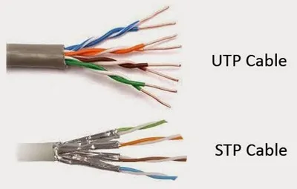
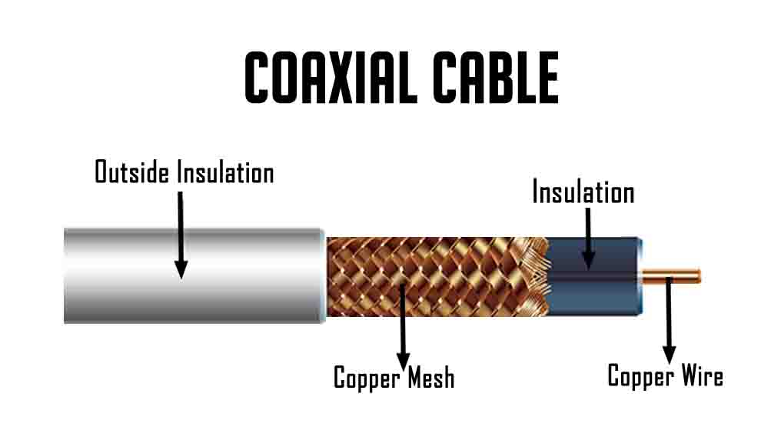
Cables (Once again)
UTP: Unshielded Twisted Pair cables
STP: Shielded Twisted Pair cables
Coax: Coaxial Cables
Fibre optics

Slide 10
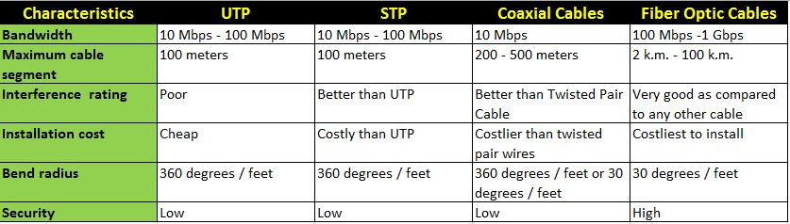
Copper vs Copper
Resource: https://www.learnabhi.com/difference-between-utp-stp-coaxial-and-fiber-optic-cable/

Slide 11
(Copper) CAT Numbers
Category | Shielding | Max Speed (@100m) (Mbps) | Max Bandwidth (MHz)
CAT 3 | Unshielded | 10 | 16
CAT 5 | Unshielded | 10 / 100 | 100
CAT 5e | Unshielded | 1,000 | 100
CAT 6 | Shielded / Unshielded | 1,000 | >250
CAT 6a | Shielded | 10,000 | 500
CAT 7 | Shielded | 100,000 | 600

Slide 12
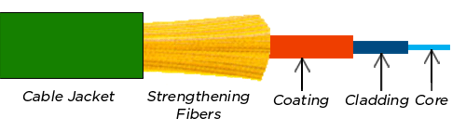
(Reminder) The anatomy of an optic fibre
Core: Where the light travels.
Cladding: Surrounds the core to keep light there via “total internal reflection”.
Coating: Reinforces its internals, usually plastic.
Strengthening fibers: “Cushion” that protects the core against tensions.
Cable Jacket: More protection (from the environment, us etc).

Slide 13

(Reminder) How many modes ( = colours)?
Monomode fibre | Multimode fibre
Driven by expensive laser | Driven by cheaper lasers
Pure light (one colour) | Many similar colours
Long distance, high bandwidth | Long distance, high bandwidth
Expensive (to buy and install) | Expensive (a bit less)
Really fragile | Fragile (a bit less)
Dangerous | Less dangerous
Hard to terminate | Not so hard to terminate

Slide 14
Layer 2: LLC and MAC Sublayers
Logical Link Control (LLC):
The “upper” sublayer of layer 2.
Connection handling between lower / upper layers.
Adds control info to help deliver the packet to destination.
Medium Access Control (MAC):
The “lower” sublayer of layer 2.
Data encapsulation.
Media access control.
Mostly hardware.

Slide 15
MAC Sublayer
Encapsulation:
Frame assembly / disassembly.
Frames = Packets + MAC → This sublayer adds the needed header and trailers to the network layer PDU (usually packets).
Header functions:
Where frames begin / end (frame delimiting).
Addressing (MAC address).
Error detection (more on that in the near future).

Slide 16
Collision Management
Old-school: Carrier Sense Multiple Access - Collision Detection (CSMA/CD):
Is there any signal carried by the medium (cable)?
If no → send data.
If yes → collision!
How to solve? → Wait a random amount of time.
Ethernet 802.11: Collision Avoidance (CSMA/CA):
Is there any signal carried by the medium (cable)?
If no → send a notification that you want to use it.
If no one objects → send data.

Slide 17
Frames and Switches
MAC addresses include a lot of information about a device.
Usually, Network Interface Cards (NIC) decapsulate that information to see if it matches its destination device.
Layer 2 switching is performed based only on the MAC address.
Subnetting is left on routers and IP addressing…

Slide 18
Remembering MAC addresses
Broadcast signal on port P1 from the orange machine.
The switch stores the ingress port and the sending MAC.
The switch broadcasts the message to all other ports (flooding).
The blue machine responds with a unicast frame (port P2).
The switch notes down port and MAC.
Knowing ports and addresses of the two devices, the switch can now implement flood-less bilateral communication.
^{P1}
^{P2}
^{P4}
^{P3}

Slide 19
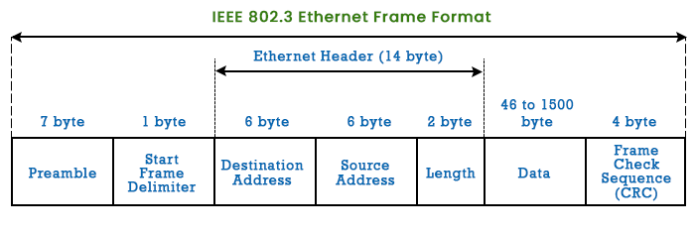
Ethernet Frames
64 – 1518 bytes (sometimes +4B).
Packets out of those boundaries are dropped.
NIC checks the FCS and if it is correct, it drops it, otherwise it drops the entire packet.

Slide 20
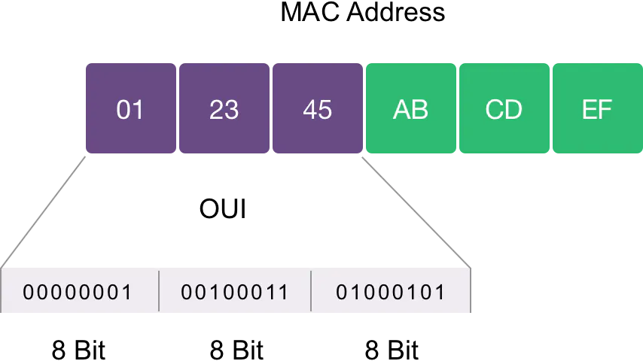
MAC Addresses
Open up a terminal / cmd and hit: ipconfig /all
What do you see?
What are those letters in MAC addresses?
HEX digits, of course!
48 bits, in total.

Slide 21
Special MAC
All zeros: 00000000 00000000:00000000 00000000:00000000 00000000
Placeholder → Address not known yet.
All ones: 11111111 11111111:11111111 11111111:11111111 11111111
Broadcast → Send to all
MAC starting with 01-00-5E → Multicast
How does this work?
Bitwise masking.
All ones in HEX?
FFFF:FFFF:FFFF → Only 12 (48 / 4) digits, since 16 = 2⁴.

Slide 22
Binary Operations: OR
Y OR 1 = 1, Y OR 0 = Y, i.e.:
0 OR 0 = 0
0 OR 1 = 1
1 OR 0 = 1
1 OR 1 = 1
Essentially, an OR bitmask can turn a bit to 1 (turn on). Assume that we want to turn the first four bits of 10101101 to 1. Then:
10101101 OR 11110000 11111101

Slide 23
Binary Operations: AND
Y AND 1 = Y, Y AND 0 = 0, i.e.:
0 AND 0 = 0
0 AND 1 = 0
1 AND 0 = 0
1 AND 1 = 1
Essentially, an AND bitmask can turn a bit to 0 (turn off). Assume that we want to turn the first four bits of 10101101 to 0. Then:
10101101 AND 00001111 00001101

Slide 24
Use case: Querying certain bits
Consider the following bitstring:
10011110 01110101
How can we easily query the status of their sixth bit (i.e., whether they are on or off)?
By using an AND bitmask and then comparing to zero:
10011110 AND 00100000 00000000
01110101 AND 00100000 00100000

Slide 25
Application: Choosing Among Options
Imagine a case where you have four binary options: A, B, C, D.
This can be encoded by a nibble (half-byte) such as: 0011, which would mean that A and B are “off” while C and D are “on”.
Assume now that you want to just find out what’s going on with option C in the above. How can you achieve that with bitmasks?
Use an AND mask on the second digit and compare to 0:
0011 AND 0010 0010
1101 AND 0010 0000
Option C: “On”
Option C: “Off”

Slide 26
MAC vs IP
MAC Address:
Does not change
Physical address (assigned to NIC)
Assigned by Manufacturer (as per IEEE instructions)
IP Address:
Can change (like your postal address)
Bases on host location
Logical address
Assigned by network admin each time it is required
To deliver a message you need both MAC and IP! → To deliver a letter you need both name and address!

Slide 27
ARP: Address Resolution Protocol
How can we know the MAC address of a device inside a network to send a message to it, while we stay outside of it?
We can’t. And we shouldn’t guess it (MAC do not relate to physical location).
How can we know the IP address of a network to send a message to it?
Easily, this is decided at the logical level and is publicly available.
It would be nice if MAC were like IP…
ARP:
Resolves IPv4 addresses to MAC ones.
Remembers what it has resolved to what.

Slide 28
ARP: How it works
(Alice) Hey, I want to share this message with John Doe, at Amazing Street 128, but I don’t know where John lives in…
(Messy the Messenger) Don’t worry, I can handle this. [Takes a deep breath] DOES ANYONE KNOW WHO THIS BELONGS TO?
[some time passes]
(John Doe) Hey, this is mine…
(M) Okay, where do you live in? [Proceeds to note down the address]

Slide 29
ARP: How it works
(Alice) Hey, I want to share this message with MAC Unknown, at 192.168.1.254, but I don’t know where the MAC…
(Messy the Messenger) Don’t worry, I can handle this. [Takes a deep breath] BROADCAST: FFFF:FFFF:FFFF
[some time passes]
(0F-10-02-10-20-30) Hey, this is mine…
(M) Okay, where do you live in? [192.168.1.254 → 0F-10-02-10-20-30]

Slide 30
ARP: How it works
Note down any incoming IP + MAC (for future use).
When you don’t know what to do:
Broadcast incoming messages to all devices (known IP, “all ones” MAC).
If there is someone to respond → Note down their MAC.
If no response is received → Well, nothing to do, drop the packet.
Overall:
If the destination IPv4 host is on the LAN, then the destination MAC is that of this device (@ this host).
If the destination IPv4 host is not on the LAN, the destination MAC is determined by the ARP process (table look-up).
If the ARP table does not include a valid entry, make a request (shout out) to get the MAC address related to that IP.
Open up terminal / cmd and hit: arp -a

Slide 31
What we saw today… 1 / n
In which layers does Ethernet operate?
Layer 1 (physical), since it is related signal transmission (remember the cables?)
Layer 2 (data link), since it connects physical devices (implements the LAN).
Name some typical cable types.
UTP: Unshielded Twisted Pair cables
STP: Shielded Twisted Pair cables
Coax: Coaxial Cables
Fibre optics

Slide 32
What we saw today… 2 / n
Compare UTP, STP, Coax and Fibre cables.

Slide 33
What we saw today… 3 / n
What are the LLC and MAC Layer 2 sublayers?
Logical Link Control (LLC):
The “upper” sublayer of layer 2.
Connection handling between lower / upper layers.
Adds control info to help deliver the packet to destination.
Medium Access Control (MAC):
The “lower” sublayer of layer 2.
Data encapsulation.
Media access control.
Mostly hardware.

Slide 34
What we saw today… 4 / n
What does CSMA/CD stand for? How does it work?
CSMA/CD stands for Carrier Sense Multiple Access / Collision Detection. It works as follows:
Is there any signal carried by the medium (cable)?
If no → send data.
If yes → collision!
How to solve? → Wait a random amount of time.

Slide 35
What we saw today… 5 / n
What does CSMA/CA stand for? How does it work?
CSMA/CA = Carrier Sense Multiple Access / Collision Avoidance. It works as follows:
Is there any signal carried by the medium (cable)?
If no → send a notification that you want to use it.
If no one objects → send data.

Slide 36
What we saw today… 6 / n
What is the structure of an Ethernet frame (bytes, headers etc)?

Slide 37
What we saw today… 7 / n
Name some special MAC addresses and their purpose.
All zeros: 00000000 00000000:00000000 00000000:00000000 00000000
Placeholder → Address not known yet.
All ones: 11111111 11111111:11111111 11111111:11111111 11111111
Broadcast → Send to all
MAC starting with 01-00-5E → Multicast

Slide 38
What we saw today… 8 / n
Compare MAC and IP Addresses.
MAC Address:
Does not change
Physical address (assigned to NIC)
Assigned by Manufacturer (as per IEEE instructions)
IP Address:
Can change (like your postal address)
Bases on host location
Logical address
Assigned by network admin each time it is required

Slide 39
What we saw today… 9 / n
How does ARP work?
Note down any incoming IP + MAC (for future use).
When you don’t know what to do:
Broadcast incoming messages to all devices (known IP, “all ones” MAC).
If there is someone to respond → Note down their MAC.
If no response is received → Well, nothing to do, drop the packet.
Overall:
If the destination IPv4 host is on the LAN, then the destination MAC is that of this device (@ this host).
If the destination IPv4 host is not on the LAN, the destination MAC is determined by the ARP process (table look-up).
If the ARP table does not include a valid entry, make a request (shout out) to get the MAC address related to that IP.

Slide 40
(Reminder) Homework
This is a bi-weekly assignment (it will span two weeks, so make your time management accordingly).
Read the following chapter found in ‘Our Stuff > network_design_principles.pdf’.
Provide a summary of at least 700 words of the main concepts of this chapter.
The aim of this assignment is to help you in summarising stuff you find from certain source. Avoid using the same wording / phrasing as in the book. Try to be as concise and accurate as possible and try to not go too much beyond 700 words (1000 words is acceptable, 2000 words is not).

Slide 41
Fun Time!

Slide 42
ARP Lab
Open ‘labs > Week 6 Tutorial1_Examine the ARP Table.7z’ and follow the tutorial therein.
Also, don’t forget to complete any lab exercises from previous weeks!

Slide 43
Really interesting materials
Check out this youtube playlist:
https://www.youtube.com/watch?v=nlKu93Gb6GQ&list=PLvUOx2WG6R7PlKlERb5zceXxHfC4P7gJn
Many projects that will look like your final assignment!

Slide 44
(Reminder) NetAcad Courses
In the “Download Packet Tracer” page, above the “Download” section, you can find three interesting courses (interesting course: a course is characterised as “interesting” to inform someone that they should take it, without telling them to do so directly):
Getting Started with Cisco Packet Tracer
Exploring Networking with Cisco Packet Tracer
Exploring IoT with Cisco Packet Tracer
Also interesting is the following NetAcad course:
Network Technician

Slide 45

Any Questions?
Don’t forget to fill-in the questionnaire! (look right)
https://forms.gle/6q2tuByroaan8kWH8

